Slide 1
Object Interactive
Weiwei Xu

Slide 2
C'tor and D'tor

Slide 3
Point::init()
class Point {
public:
void init(int x, int y);
void print() const;
void move(int dx, int dy);
private:
int x;
int y;
};
Point a;
a.init(1,2);
a.move(2,2);
a.print();

Slide 4
Guaranteed initialization with the constructor
•
If a class has a constructor, the compiler automatically calls that constructor at the point an object is created, before client programmers can get their hands on the object.
The name of the constructor is the same as the name of the class.
•

Slide 5








How a constructor does?
class X { int i;
public: X();
};

Slide 6

How a constructor does?
class X { int i;
public: X();
};
constructor

Slide 7






How a construcor does?
class X { int i;
public: X();
};
constructor
void
f() {
X a;
// ...
}

Slide 8
How a construcor does?
class X { int i;
public: X();
};
constructor
void
f() {
X a;
// ...
a.X();
}

Slide 9
Constructors with arguments
•
The constructor can have arguments to allow you to specify how an object is created, give it initialization values, and so on.
Tree(int i) {…} Tree t(12);
•
Constructor1.cpp

Slide 10
The default constructor
A default constructor is one that can be called with no arguments

Slide 11

The default constructor
A default constructor is one that can be called with no arguments
struct Y {
float f; int i; Y(int a);
};

Slide 12

The default constructor
A default constructor is one that can be called with no arguments
struct Y {
float f; int i; Y(int a);
};
Y y1[] = { Y(1), Y(2), Y(3) };

Slide 13
The default constructor
A default constructor is one that can be called with no arguments
struct Y {
float f; int i; Y(int a);
};
Y y1[] = { Y(1), Y(2), Y(3) };
Y y2[2] = { Y(1) , Y(2) };

Slide 14
The default constructor
A default constructor is one that can be called with no arguments
struct Y {
float f; int i; Y(int a);
};
Y y1[] = { Y(1), Y(2), Y(3) };
Y y2[2] = { Y(1) }; Y y3[7];

Slide 15
The default constructor
A default constructor is one that can be called with no arguments
struct Y {
float f; int i; Y(int a);
};
Y y1[] = { Y(1), Y(2), Y(3) };
Y y2[2] = { Y(1) }; Y y3[7];
Y y4;

Slide 16
“auto” default constructor

Slide 17
“auto” default constructor
If you have a constructor, the compiler ensures
that construction always happens.

Slide 18
“auto” default constructor
If you have a constructor, the compiler ensures
that construction always happens.
If (and only if) there are no constructors for a
class (struct or class), the compiler will
automatically create one for you.
Example: AutoDefaultConstructor.cpp

Slide 19
The destructor
In C++, cleanup is as important as initialization and is
therefore guaranteed with the destructor
The destructor is named after the name of the class
with a leading tilde (~). The destructor never has any
arguments.

Slide 20

The destructor
In C++, cleanup is as important as initialization and is
therefore guaranteed with the destructor
The destructor is named after the name of the class
with a leading tilde (~). The destructor never has any
arguments.
class Y { public:
~Y();
};

Slide 21
When is a destructor called?
The destructor is called automatically by the
compiler when the object goes out of scope.
The only evidence for a destructor call is the
closing brace of the scope that surrounds the
object.

Slide 22
Storage allocation

Slide 23
Storage allocation
The compiler allocates all the storage for a
scope at the opening brace of that scope.

Slide 24
Storage allocation
The compiler allocates all the storage for a
scope at the opening brace of that scope.
The constructor call doesn’t happen until the
sequence point where the object is deﬁned.
Example: Nojump.cpp

Slide 25
Aggregate initialization

Slide 26
Aggregate initialization
int a[5] = {1,2,3,4,5};

Slide 27
Aggregate initialization
int a[5] = {1,2,3,4,5};
int b[6] = {5};

Slide 28
Aggregate initialization
int a[5] = {1,2,3,4,5};
int b[6] = {5};
int c[] = {1,2,3,4};
- sizeof c / sizeof *c
struct x { int i; float f; char c; };
- X x1 = {1, 2.2, 'c'};

Slide 29
Aggregate initialization
int a[5] = {1,2,3,4,5};
int b[6] = {5};
int c[] = {1,2,3,4};
- sizeof c / sizeof *c
struct x { int i; float f; char c; };
- X x1 = {1, 2.2, 'c'};
X x2[3] = { {1, 1.1, 'a'}, {2, 2.2, 'b'} }
struct Y { float f; int i; Y(int a); };

Slide 30
Aggregate initialization
int a[5] = {1,2,3,4,5};
int b[6] = {5};
int c[] = {1,2,3,4};
- sizeof c / sizeof *c
struct x { int i; float f; char c; };
- X x1 = {1, 2.2, 'c'};
X x2[3] = { {1, 1.1, 'a'}, {2, 2.2, 'b'} }
struct Y { float f; int i; Y(int a); };
Y y1[] = { Y(1), Y(2), Y(3) };

Slide 31
Clock display

Slide 32
Abstract
Abstraction is the ability to ignore details of
parts to focus attention on a higher level of a
problem.
Modularization is the process of dividing a
whole into well-defined parts, which can be
built and examined separately, and which
interact in well-defined ways.

Slide 33



Modularizing the clock display
One four-digit display?
Or two two- digit displays?

Slide 34
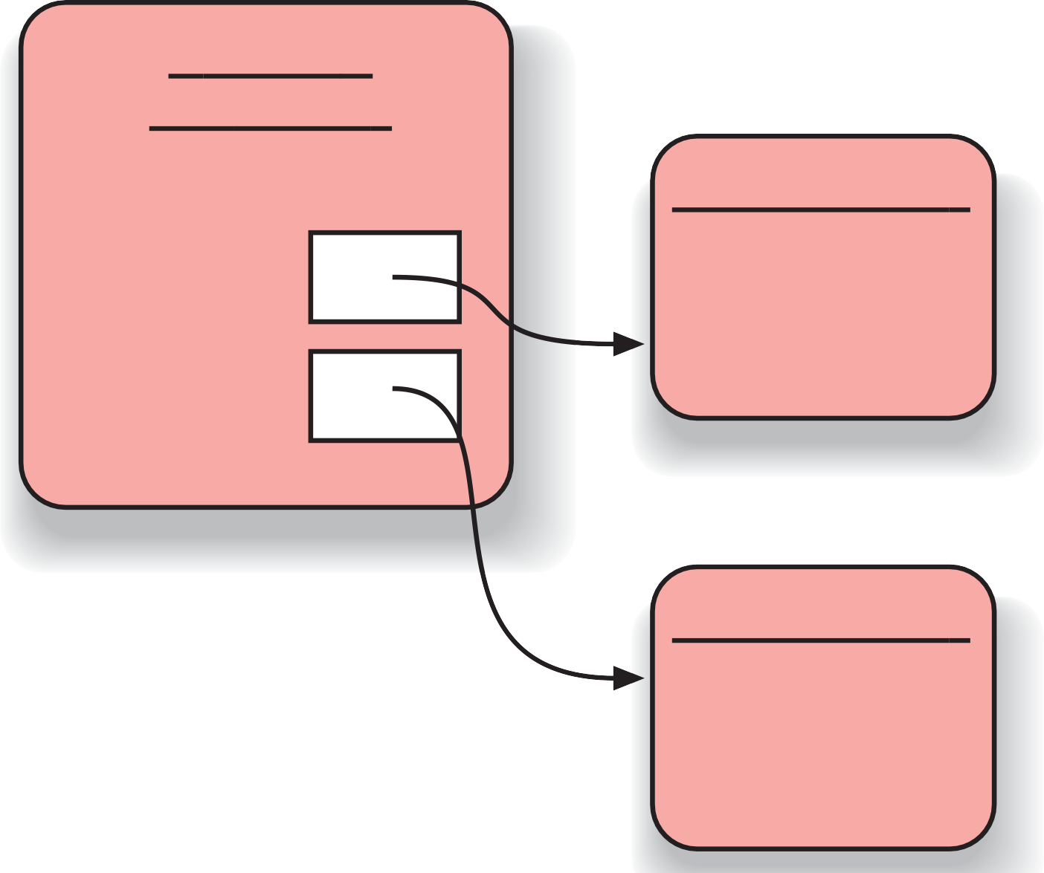


Object & Classes
myDisplay: ClockDisplay
ClockDisplay
:NumberDisplay
hours
11
minutes
NumberDisplay
:NumberDisplay
03
(a)
(b)
a)
b)

Slide 35
Class Diagram
ClockDisplay
-hours : NumberDisplay -minutes : NumberDisplay
+start()
NumberDisplay
- l imit : int
-value : int
+increase() : boolean

Slide 36
Implementation - ClockDisplay
class ClockDisplay { NumberDisplay hours; NumberDisplay minutes;
Constructor and methods omitted.
}

Slide 37
Implementation - ClockDisplay
class NumberDisplay { int limit;
int value;
Constructor and methods omitted.
}

Slide 38
local variable
•
Local variables are defined inside a method,
have a scope limited to the method to which
they belong.

Slide 39

local variable
• Local variables are defined inside a method, have a scope limited to the method to which they belong.
int TicketMachine::refundBalance() { int amountToRefund; amountToRefund = balance; balance = 0;
return amountToRefund;
}

Slide 40


local variable
• Local variables are defined inside a method, have a scope limited to the method to which they belong.
int TicketMachine::refundBalance() { int amountToRefund; amountToRefund = balance; balance = 0;
return amountToRefund;
}
A local variable of the same name as a field will prevent the field from being accessed within a method.

Slide 41
Fields,parameters,local variables
•
•
•
All three kinds of variable are able to store a value that is
appropriate to their defined type.
Fields are defined outside constructors and methods
Fields are used to store data that persists throughout the life of an object. As such, they maintain the current state of an object. They have a lifetime that lasts as long as their object lasts.
•
Fields have class scope: their accessibility extends
throughout the whole class, and so they can be used within any of the constructors or methods of the class in which they are defined.

Slide 42
•
As long as they are defined as private, fields cannot be
accessed from anywhere outside their defining class.
•
Formal parameters and local variables persist only for the period that a constructor or method executes. Their lifetime is only as long as a single call, so their values are lost between calls. As such, they act as temporary rather than permanent storage locations.
•
Formal parameters are defined in the header of a constructor or method. They receive their values from outside, being initialized by the actual parameter values that form part of the constructor or method call.

Slide 43
Formal parameters have a scope that is limited to their defining constructor or method.
•
•
Local variables are defined inside the body of a constructor or method. They can be initialized and used only within the body of their defining constructor or method.
•
•
Local variables must be initialized before they are used in an expression – they are not given a default value.
Local variables have a scope that is limited to the block in
which they are defined. They are not accessible from
anywhere outside that block.

Slide 44
Initialization

Slide 45
Member Init
Directly initialize a member
benefit: for all ctors
Only C++ 11 works

Slide 46

Initializer list
class Point { private:
const float x, y;
xa =
Point(float
0.0, float
{}
ya = 0.0)
: y(ya),
x(xa)
};
•
Can initialize any type of data
pseudo-constructor calls for built-ins
No need to perform assignment within body of ctor Order of initialization is order of declaration
Not the order in the list!
Destroyed in the reverse order.
•

Slide 47
Initialization vs. assignment

Slide 48
Initialization vs. assignment
Student::Student(string
initialization
before constructor
Student::Student(string
assignment
s):name(s) {}
s) {name=s;}

Slide 49
Initialization vs. assignment
Student::Student(string
initialization
before constructor
Student::Student(string
assignment
inside constructor
s):name(s) {}
s) {name=s;}
string must have a default constructor

Slide 50
Function overloading
Same functions with different arguments list.
void print(char * str, int width); // #1
void print(double d, int width); // #2
void print(long l, int width); // #3
void print(int i, int width); // #4
void print(char *str); // #5
print("Pancakes", 15);
print("Syrup");
print(1999.0, 10);
print(1999, 12);
print(1999L, 15);
Example: leftover.cpp

Slide 51
Overload and auto-cast
void f(short i);
void f(double d);
f(‘a’); f(2);
f(2L);
f(3.2);
Example: overload.cpp

Slide 52
Default arguments
•
A default argument is a value given in the declaration that the compiler automatically inserts if you don’t provide a value in the function call.
Stash(int size, int initQuantity = 0);

Slide 53
To define a function with an argument list, defaults must be added from right to left.
int harpo(int n, int m = 4, int j = 5);
int chico(int n, int m = 6, int j);//illeagle
int groucho(int k = 1, int m = 2, int n = 3);
beeps = harpo(2);
beeps = harpo(1,8);
beeps = harpo(8,7,6);
Example: left.cpp

Slide 54
const object

Slide 55
Constant objects

Slide 56
Constant objects
•
What if an object is const?
const Currency the_raise(42, 38);
•
What members can access the internals?

Slide 57
Constant objects
•
What if an object is const?
const Currency the_raise(42, 38);
•
What members can access the internals?
•
How can the object be protected from change?

Slide 58
Constant objects
•
What if an object is const?
const
Currency
the_raise(42,
38);
•
What members can access the internals?
•
How can the object be protected from change?
•
Solution: declare member functions const
–
Programmer declares member functions to be safe

Slide 59
Const member functions
•
Cannot modify their objects
int Date::set_day(int d){
//...error check d here...
day = d; // ok, non-const so can modify
}
int Date::get_day() const {
day++; //ERROR modifies data member
set_day(12); // ERROR calls non-const member
return day; // ok
}

Slide 60
Const member function usage
•
Repeat the const keyword in the definition as well as the declaration
int get_day () const;
int get_day() const { return day };
Function members that do not modify data should be declared const
•
•
const member functions are safe for const objects

Slide 61
Const objects

Slide 62
Const objects
•
Const and non-const objects
// non-const object
Date when(1,1,2001); // not a const
int day = when.get_day(); // OK
when.set_day(13); // OK
// const object
const Date birthday(12,25,1994); // const
int day = birthday.get_day(); // OK
birthday.set_day(14); // ERROR

Slide 63
Constant in class
class A {
const int i;
};
•
has to be initialized in initializer list of the constructor

Slide 64
Compile-time constants in classes

Slide 65
Compile-time constants in classes
class HasArray {
const int size;
int array[size]; // ERROR!
...
};

Slide 66
Compile-time constants in classes
class HasArray {
const int size;
int array[size]; // ERROR!
...
};
Make the const value static:
- static const int size = 100;
- static indicates only one per class (not one per object)

Slide 67
Compile-time constants in classes
class HasArray {
const int size;
int array[size]; // ERROR!
...
};
Make the const value static:
- static const int size = 100;
- static indicates only one per class (not one per object)
Or use “anonymous enum” hack:
Class HasArray{
enum { size = 100 };
int array[size]; // OK!
…
}

Slide 68
type of function parameters and return value

Slide 69
way in
•
void f(Student i);
•
a new object is to be created in f
•
void f(Student *p);
•
better with const if no intend to modify the object
•
void f(Student& i);
•
better with const if no intend to modify the object

Slide 70
way out
•
Student f();
•
a new object is to be created at returning
•
Student* f();
•
what should it points to?
•
Student& f();
•
what should it refers to?

Slide 71
hard decision
char *foo()
{
char *p;
p = new char[10]; strcpy(p, "something"); return p;
}
void bar()
{
char *p = foo(); printf("%s", p); delete p;
}

Slide 72

hard decision
char *foo()
{
define a pair functions of alloc and free
char *p;
p = new char[10]; strcpy(p, "something"); return p;
}
void bar()
{
char *p = foo(); printf("%s", p); delete p;
}

Slide 73

hard decision
char *foo()
{
define a pair functions of alloc and free
char *p;
p = new char[10]; strcpy(p, "something"); return p;
}
void bar()
{
char *p = foo(); printf("%s", p); delete p;
}
Let user take resp., pass pointers in & out

Slide 74
tips
•
Pass in an object if you want to store it
•
Pass in a const pointer or reference if you want to get the values
•
Pass in a pointer or reference if you want to do something to it
•
Pass out an object if you create it in the function
•
Pass out pointer or reference of the passed in only
•
Never new something and return the pointer

Slide 75
Container

Slide 76
A personal notebook
It allows notes to be stored.
It has no limit on the number of notes it can
store.
It will show individual notes.
It will tell us how many notes it is currently
storing.

Slide 77
Collection
Collection objects are objects that can store an arbitrary number of other objects.

Slide 78
What is STL
STL = Standard Template Library
Part of the ISO Standard C++ Library
Data Structures and algorithms for C++.

Slide 79
Why should I use STL?
Reduce development time.
–Data-structures already written and debugged.
Code readability
–Fit more meaningful stuff on one page.
Robustness
–STL data structures grow automatically.
Portable code.
Maintainable code
Easy

Slide 80
C++ Standard Library
Library includes:
–A Pair class (pairs of anything, int/int, int/char, etc)
–Containers
Vector (expandable array)
Deque (expandable array, expands at both ends)
List (double-linked)
Sets and Maps
–Basic Algorithms (sort, search, etc)
All identifiers in library are in std namespace
using namespace std;

Slide 81
The three parts of STL
Containers
Algorithms
Iterators

Slide 82
The ‘Top 3’ data structures
map
–Any key type, any value type.
–Sorted.
vector
–Like c array, but auto-extending.
list
–doubly-linked list

Slide 83
All Sequential Containers
vector: variable array
deque: dual-end queue
list: double-linked-list
forward_list: as it
array: as “array”
string: char. array

Slide 84
Example using the vector class
Use “namespace std” so that you can refer to vectors in C++ library
Just declare a vector of
ints (no need to worry about size)
Add elements
Have a pre-defined iterator for vector class,
#include <iostream>
#include <vector> using namespace std;
int main( ) {
vector<int> x;
for (int a=0; a<1000; a++) x.push_back(a);
vector<int>::iterator p;
for (p=x.begin();
p<x.end(); p++)
cout << *p << " "; return 0;
can use it to print out the items in vector
}

Slide 85
generic classes
vector<string> notes;
Have to specify two types: the type of the collection itself (here: vector) and the type of the elements that we plan to store in the collection (here: string)

Slide 86
vector
It is able to increase its internal capacity as required: as more items are added, it simply makes enough room for them.
It keeps its own private count of how many items it is currently storing. Its size method returns the number of objects currently stored in it.
It maintains the order of items you insert into it. You can later retrieve them in the same order.

Slide 87
Class Exercises
The code for the vector example exists at vector.cpp. Modify this code so it puts 5000 items in the vector, and then prints out every fifth element
–Element 0, element 5, element 10, etc.

Slide 88
Basic Vector Operations
Constructors vector<Elem> c; vector<Elem> c1(c2);
Simple Methods
Element access V.at(index)
V[index]
V.front( )
V.back( )
// first item
// last item
V.size( )
V.empty( )
// num items
// empty?
Add/Remove/Find V.push_back(e) V.pop_back( ) v.insert(pos, e)
V.erase(pos) V.clear( )
V.find(first, last, item)
==, !=, <, >, <=, >=
V.swap(v2) // swap
Iterators
I.begin( )
I.end( )
// first position
// last position

Slide 89
Class Exercises
Take a look at the code in vector2.cpp . Predict the output of this program.
Run the program to check your output.

Slide 90
List Class
Same basic concepts as vector
–Constructors
–Ability to compare lists (==, !=, <, <=, >, >=)
–Ability to access front and back of list
x.front(), x.back()
–Ability to assign items to a list, remove items
x.push_back(item), x.push_front(item) x.pop_back(), x.pop_front() x.remove(item)

Slide 91
Sample List Application
Declare a list of strings
Add elements
–Some to the back
–Some to the front
Iterate through the list
–Note the termination condition for our iterator
p != s.end( )
– Cannot use p < s.end( ) as with vectors, as the list elements may not be stored in order
#include <iostream> using namespace std;
#include <list>
#include <string>
int main( ) { list<string> s;
s.push_back("hello"); s.push_back("world"); s.push_front("tide"); s.push_front("crimson"); s.push_front("alabama"); list<string>::iterator p;
for (p=s.begin(); p!=s.end(); p++) cout << *p << " ";
cout << endl;
}

Slide 92
Maintaining an ordered list
Declare a list
#include <iostream>
using namespace std;
#include <list>
#include <string> int main( ) {
list<string> s; string t; list<string>::iterator p; for (int a=0; a<5; a++) {
cout << "enter a string : "; cin >> t;
p = s.begin();
while (p != s.end() && *p < t) p++;
s.insert(p, t);
}
for (p=s.begin(); p!=s.end(); p++)
cout << *p << " ";
Read in five strings, add them in order
Print out the ordered list
cout << endl; }

Slide 93
Maps
Maps are collections that contain pairs of values.
Pairs consist of a key and a value.
Lookup works by supplying a key, and retrieving a value.
An example: a telephone book.

Slide 94
Using maps
A map with strings as keys and values
:HashMap
"Charles | Nguyen" | "(531) | 9392 | 4587"
"Lisa | Jones" | "(402) | 4536 | 4674"
"William | H. | Smith" | "(998) | 5488 | 0123"

Slide 95
Example Program
#include <map>
#include <string>
map<string, float> price;
price[“snapple”] = 0.75;
price[“coke”] = 0.50;
string item;
double total=0;
while ( cin >> item )
total += price[item];

Slide 96
Example Program
#include <map>
#include <string>
map<string, float> price;
price[“snapple”] = 0.75;
price[“coke”] = 0.50;
string item;
double total=0;
while ( cin >> item )
total += price[item];

Slide 97
Example Program
#include <map>
#include <string>
map<string, float> price;
price[“snapple”] = 0.75;
price[“coke”] = 0.50;
string item;
double total=0;
while ( cin >> item )
total += price[item];

Slide 98
Example Program
#include <map>
#include <string>
map<string, float> price;
price[“snapple”] = 0.75;
price[“coke”] = 0.50;
string item;
double total=0;
while ( cin >> item )
total += price[item];

Slide 99
Simple Example of Map
map<long, int> root;
root[4] = 2;
root[1000000] = 1000;
long l;
cin >> l;
if (root.count(l)) cout<<root[l]
else cout<<“Not perfect square”;

Slide 100
Two ways to use Vector
Preallocate
vector <int> v(100);
v[80] = 1; // okay
v[200] = 1; // bad
Grow tail
vector<int> v2;
int i;
while (cin >> i)
v.push_back(i);

Slide 101
Example of List
list<int> L;
for(int i=1; i<=5; ++i)
L.push_back(i);
//delete second item.
L.erase( ++L.begin() );
copy( L.begin(). L.end(),
ostream_iterator<int>(cout, ","));
// Prints: 1,2,3,5

Slide 102
Iterator

Slide 103
Iterators
Declaring
list<int>::iterator li;
Front of container
list<int> L;
li = L.begin();
Past the end
li = L.end();

Slide 104
Iterators
Can increment
list<int>::iterator li;
list<int> L;
li=L.begin();
++li; // Second thing;
Can be dereferenced
*li = 10;

Slide 105
Algorithms
Take iterators as arguments
list<int> L;
vector<int> V;
// put list in vector
copy ( L.begin(),
L.end(),
V.begin() );

Slide 106
List Example Again
list<int> L;
for(int i=1; i<=5; ++i)
L.push_back(i);
//delete second item.
L.erase( ++L.begin() );
copy( L.begin(), L.end(),
ostream_iterator<int>(cout, “,”));
// Prints: 1,2,3,5

Slide 107
Typdefs
Annoying to type long names
– map<Name, list<PhoneNum> > phonebook;
– map<Name, list<PhoneNum> >::iterator finger;
Simplify with typedef
– typedef PB map<Name,list<PhoneNum> >;
– PB phonebook;
– PB::iterator finger;
Easy to change implementation.

Slide 108
Using your own classes in STL Containers
Might need:
–Assignment Operator, operator=()
–Default Constructor
For sorted types, like map<>
–Need less-than operator: operator<()
Some types have this by default:
–int, char, string
Some do not:
–char *

Slide 109
Example of User-Defined Type
struct point
{
float x;
float y;
}
vector<point> points;
point p; p.x=1; p.y=1;
points.push_back(1);

Slide 110
Example of User-Defined Type
Sorted container needs sort function.
struct full_name {
char * first;
char * last;
bool operator<(full_name & a)
{
return strcmp(first, a.first) < 0;
}
}
map<full_name,int> phonebook;

Slide 111
Performance
Personal experience 1:
–STL implementation was 40% slower than hand- optimized version.
STL: used deque
Hand Coded: Used “circular buffer” array;
–Spent several days debugging the hand-coded version.
–In my case, not worth it.
–Still have prototype: way to debug fast version.

Slide 112

Performance
Personal experience 2
Application with STL list ~5% slower than custom list.
Custom list “intrusive”
– struct foo {
int a;
foo * next;
– };
Can only put foo in one list at a time

Slide 113
Pitfalls
Accessing an invalid vector<> element.
vector<int> v;
v[100]=1; // Whoops!
Solutions:
– use push_back()
– Preallocate with constructor.
– Reallocate with reserve()
– Check capacity()

Slide 114
Pitfalls
Inadvertently inserting into map<>.
if (foo["bob"]==1)
//silently created entry “bob”
Use count() to check for a key without creating a new entry.
if ( foo.count(“bob”) )

Slide 115
Pitfalls
Not using empty() on list<> .
–Slow
if ( my_list.count() == 0 ) { ... }
–Fast
if ( my_list.empty() ) {...}

Slide 116
Pitfalls
Using invalid iterator
list<int> L;
list<int>::iterator li;
li = L.begin();
L.erase(li);
++li; // WRONG
Use return value of erase to advance
li = L.erase(li); // RIGHT

Slide 117
Common Compiler Errors
vector<vector<int>> vv;
missing space
lexer thinks it is a right-shift.
any error message with pair<...> map<a,b> implemented with pair<a,b>

Slide 118
Other data structures
set, multiset, multimap
queue, priority_queue
stack , deque
slist, bitset, valarray

